Slide 1
Developing Microservices
Dominik Sachsenhofer - July, 2018

Slide 2
What you will learn in this session: Develop and deploy a Microservices Application on a Kubernetes Cluster

Slide 3
Clone repository: git clone https://github.com/dynatrace-innovationlab/developing-microservices

Slide 4
Outline
Introduction
Part 1: Container and containerized apps
Part 2: Using a Container Registry
Part 3: Create a Microservices application
Part 4: Create a Kubernetes Cluster
Part 5: Instrument a Kubernetes Cluster with Dynatrace
Part 6: Deploy a microservice application on a Kubernetes Cluster
Recap

Slide 5
Part 1: Container and containerized apps

Slide 6
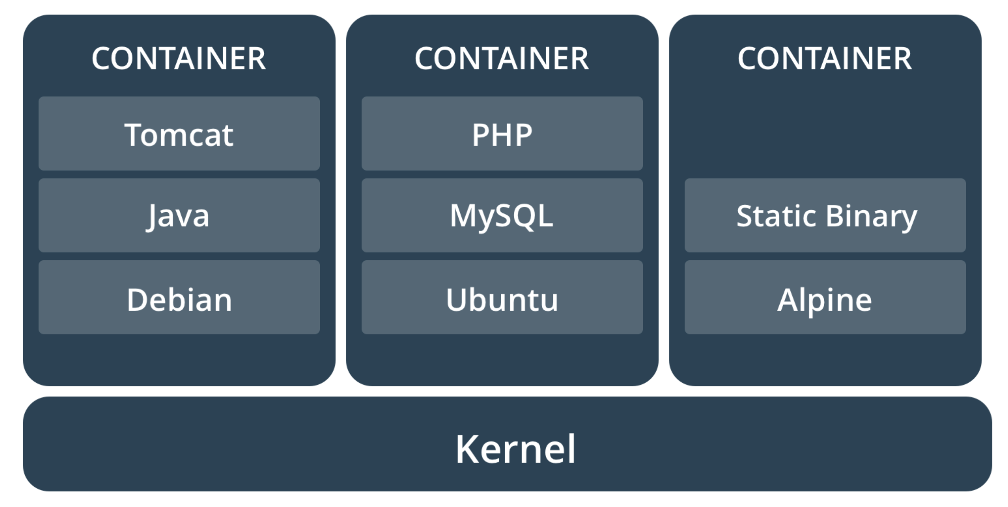
What is a Container?
A container (image) is a lightweight, stand-alone, executable package of software that includes everything needed to run it: code, runtime, system tools, system libraries, settings.

Slide 7
Comparing Containers and Virtual Machines
Containers and virtual machines have similar resource isolation and allocation benefits, but function differently because containers virtualize the operating system instead of hardware. Containers are more portable and efficient.

Slide 8
Create a containerized Python Web application
Step 1/5: Create a Python Web application:
File: directory/app.py
from flask import Flask app = Flask(__name__)
@app.route("/") def hello():
return "Hello World!”
if __name__ == '__main__‘:
app.run(debug=False, host='0.0.0.0', port=8080)

Slide 9
Create a containerized Python Web application
Step 2/5: Create a requirements.txt:
File: directory/requirements.txt
flask==0.10.1

Slide 10
Create a containerized Python Web application
Step 3/5: Create a Dockerfile:
File: directory/Dockerfile
FROM ubuntu:latest
RUN apt-get update
RUN apt-get install -y python-pip python-dev build-essential wget curl COPY . /app
WORKDIR /app
RUN pip install -r requirements.txt
EXPOSE 8080
ENTRYPOINT ["python"]
CMD ["app.py"]

Slide 11
Create a containerized Python Web application
Step 4/5: Build the Docker container:
$ docker build –t dynatrace-innovationlab/hello-world:latest .

Slide 12
Create a containerized Python Web application
Step 5/5: Run the Docker container:
$ docker run –p 8080:8080 dynatrace-innovationlab/hello-world:latest

Slide 13
Lab 1: Create a containerized Python web application

Slide 14
Part 2: Using a Container Registry

Slide 15
What is a Container Registry?
In a Container Registry you can store, manage, and secure your Docker container images.
Contrainer Registry Features:
Vulnerability Scanning
Container Tags
Automated Build Triggers

Slide 16
Pull/Push images from/to a Container Registry
Step 1/4: Build the image:
$ sudo docker build -t sai-research/hello-world:latest .

Slide 17
Pull/Push images from/to a Container Registry
Step 2/4: Tag the image:
$ sudo docker tag sai-research/hello-world:latest eu.gcr.io/sai-research/hello-world:latest

Slide 18
Pull/Push images from/to a Container Registry
Step 3/4: Push the image to the Container Registry:
$ sudo docker push eu.gcr.io/sai-research/hello-world:latest

Slide 19
Pull/Push images from/to a Container Registry
Step 4/4: Pull the image from the Container Registry:
$ sudo docker pull eu.gcr.io/sai-research/hello-world:latest

Slide 20
Lab 2: Pull/Push images from/to a Container Registry

Slide 21
Part 3: Create a microservices application

Slide 22
Define the application
TODO APP

Slide 23
Define the microservices/architecture
UI
~ Frontend
~ Backend
~ Database
Technologies: Node.js/Express.js
Image: alpine
USER
TASK
Technologies: Python/Flask
Technologies: Python/Flask
Image: ubuntu
Image: ubuntu
USER DB
TASK DB
Technologies: MongoDB
Technologies: MongoDB
Image: mongo
Image: mongo

Slide 24
Define the endpoints
UI
UI Endpoints:
http://todo-ui-svc:8080
http://todo-ui-svc:8080/dashboard
http://todo-ui-svc:8080/task/add_task
http://todo-ui-svc:8080/task/delete_task
http://todo-ui-svc:8080/user/register
http://todo-ui-svc:8080/user/signin
http://todo-ui-svc:8080/user/signout
Technologies: Node.js/Express.js
Image: alpine
USER
TASK
Technologies: Python/Flask
Technologies: Python/Flask
Image: ubuntu
Image: ubuntu
USER DB
TASK DB
Technologies: MongoDB
Technologies: MongoDB
Image: mongo
Image: mongo

Slide 25
Define the endpoints
UI
USER Endpoints:
http://todo-user-svc:8080
http://todo-user-svc:8080/health
http://todo-user-svc:8080/register_user
http://todo-user-svc:8080/delete_user
http://todo-user-svc:8080/list_users
Technologies: Node.js/Express.js
Image: alpine
USER
TASK
Technologies: Python/Flask
Technologies: Python/Flask
Image: ubuntu
Image: ubuntu
USER DB
TASK DB
Technologies: MongoDB
Technologies: MongoDB
Image: mongo
Image: mongo

Slide 26
Define the endpoints
UI
USER DB Endpoints:
mongodb://todo-user-db-svc:27017
Technologies: Node.js/Express.js
Image: alpine
USER
TASK
Technologies: Python/Flask
Technologies: Python/Flask
Image: ubuntu
Image: ubuntu
USER DB
TASK DB
Technologies: MongoDB
Technologies: MongoDB
Image: mongo
Image: mongo

Slide 27
Define the endpoints
UI
TASK Endpoints:
http://todo-task-svc:8080
http://todo-task-svc:8080/health
http://todo-task-svc:8080/add_task
http://todo-task-svc:8080/delete_task
http://todo-task-svc:8080/list_tasks
Technologies: Node.js/Express.js
Image: alpine
USER
TASK
Technologies: Python/Flask
Technologies: Python/Flask
Image: ubuntu
Image: ubuntu
USER DB
TASK DB
Technologies: MongoDB
Technologies: MongoDB
Image: mongo
Image: mongo

Slide 28
Define the endpoints
UI
TASK DB Endpoints:
mongodb://todo-task-db-svc:27017
Technologies: Node.js/Express.js
Image: alpine
USER
TASK
Technologies: Python/Flask
Technologies: Python/Flask
Image: ubuntu
Image: ubuntu
USER DB
TASK DB
Technologies: MongoDB
Technologies: MongoDB
Image: mongo
Image: mongo

Slide 29
Lab 3: Create a microservices application

Slide 30
Part 4: Create a Kubernetes Cluster

Slide 31
What is a Kubernetes Cluster?
MASTER NODE
Kubernetes API
…
WORKER NODE 1
WORKER NODE 2
WORKER NODE 3
kubelet
kubelet
kubelet
…
…
…

Slide 32
What is a Kubernetes Cluster?
DEPLOYMENTS
SERVICES

Slide 33
Lab 4: Create a Kubernetes Cluster

Slide 34
Part 5: Instrument a Kubernetes Cluster with Dynatrace

Slide 35
Lab 5: Instrument a Kubernetes Cluster with Dynatrace

Slide 36
Part 6: Deploy a microservices application on a Kubernetes Cluster

Slide 37
Lab 6: Deploy a microservices application on a Kubernetes Cluster

Slide 38
Deliver high performance to your customers

Slide 39
Build better software faster

Slide 40
Analyze user behavior to optimize customer experience

Slide 41
Compare behavior and conversions across all channels

Slide 42
Use a single platform to analyze application performance throughout your application’s full stack

Slide 43
Be the one who monitors

Slide 44
Easy access to global experts

Slide 45
Application performance monitoring for retail & ecommerce

Slide 46
Cloud monitoring taken to the next level

Slide 47
Dynatrace would have told you!

Slide 48





Slide 49




Slide 50
Get the latest icons from the asset library! http://assets.dynatrace.vmta

